Slide 1

BIG DATA AND DATA MINING. SQL PRESENTATION
Electronics Annual Review
By Christian Somtoo Obiechina. 202214049.
Notes:
Line spacing + Page numbers

Slide 2
Contents
01 Introduction
02 ER Diagram
03 Queries.
04 Feedbacks & Opportunities.

Slide 3
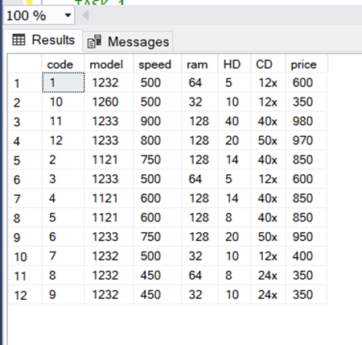
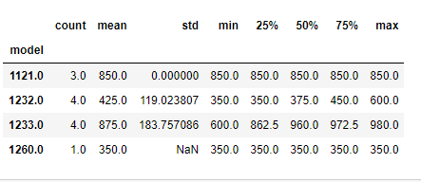
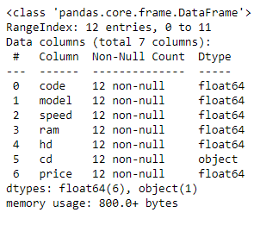
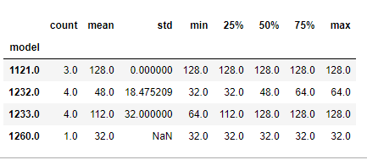
INTRODUCTION
01

Slide 4
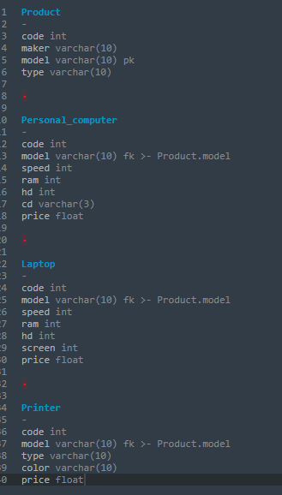
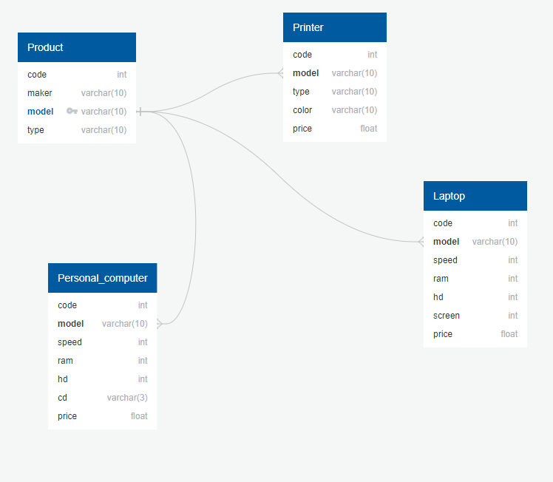
ER Diagram.
02

Slide 5
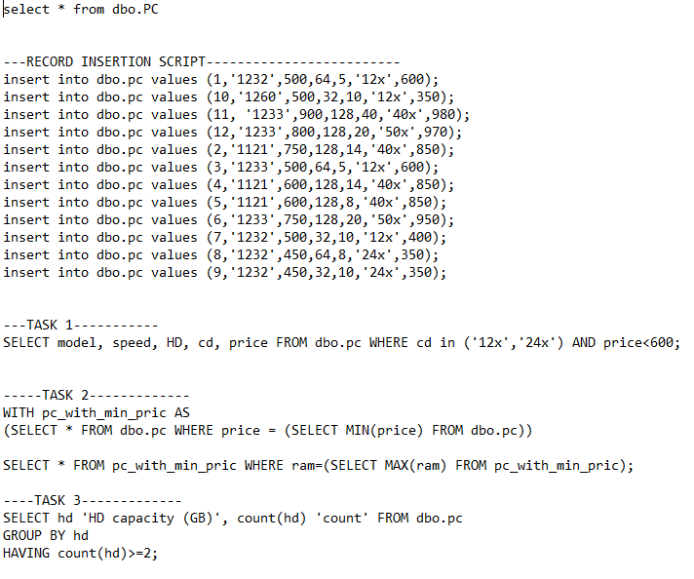
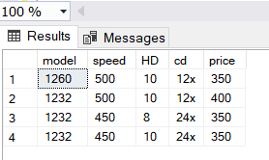
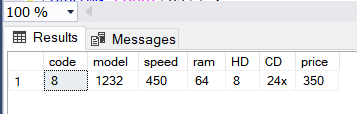

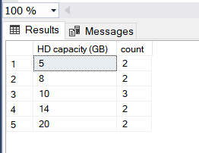
03
Queries
Task 1
Task 2
Task 3

Slide 6


Feedbacks
First query offers details on a particular subset of PCs that fit specified requirements, which may be helpful for several tasks including price analysis or inventory management.
Second query could be useful for locating the most affordable PC with the most RAM.
This query may be helpful in determining which HD capabilities are most prevalent among the PCs in stock, which may help with marketing or purchasing decisions
Principal Opportunities
Increase the stock of PCs with 12x and 24x.
Reduce the price of PC model with the lowest price.
Stock more models with higher HD to meet demands.
A better price-performance ratio than the present models is something to keep in mind while launching new PC models.

Slide 7
Thank You!
05

